Slide 1
Hyper-Connectivity and Real-Time Innovation in Industrial Sites: Collaverse
Spatial Collaboration Platform for
Semiconductor and High-Tech Manufacturing
Company & Product Profile

Slide 2


Executive Summary
Collaverse at a Glance
An industrial spatial and operations platform for semiconductor Fab construction and operation
—applied and verified in real manufacturing environments for 12+ years.
Integrates design, construction, and operation data based on space and time, treating fabs as continuously evolving operational systems with data continuity maintained through operations.
The Challenge
Data and change history fragmented across CAD,
documents, and files. Design intent lost after construction with no accumulated basis for operational decisions.
The Solution
Single spatial, object-based data structure with time-based change history accumulation and traceability. Enables independent collaboration while preserving operational data
continuity.
Built for secure collaboration
Proven at Scale
Collaverse supports secure external collaboration and
offers encrypted, version‑controlled collaboration data
(CVX) designed for security‑restricted environments while
maintaining real‑time traceability.
Deployed across 23 global semiconductor Fab projects
(incl. Taylor, TX) with zero data integrity failures
since 2013; operating at Fab scale (e.g., 2.2M㎡ space,
86,000km piping).

Slide 3
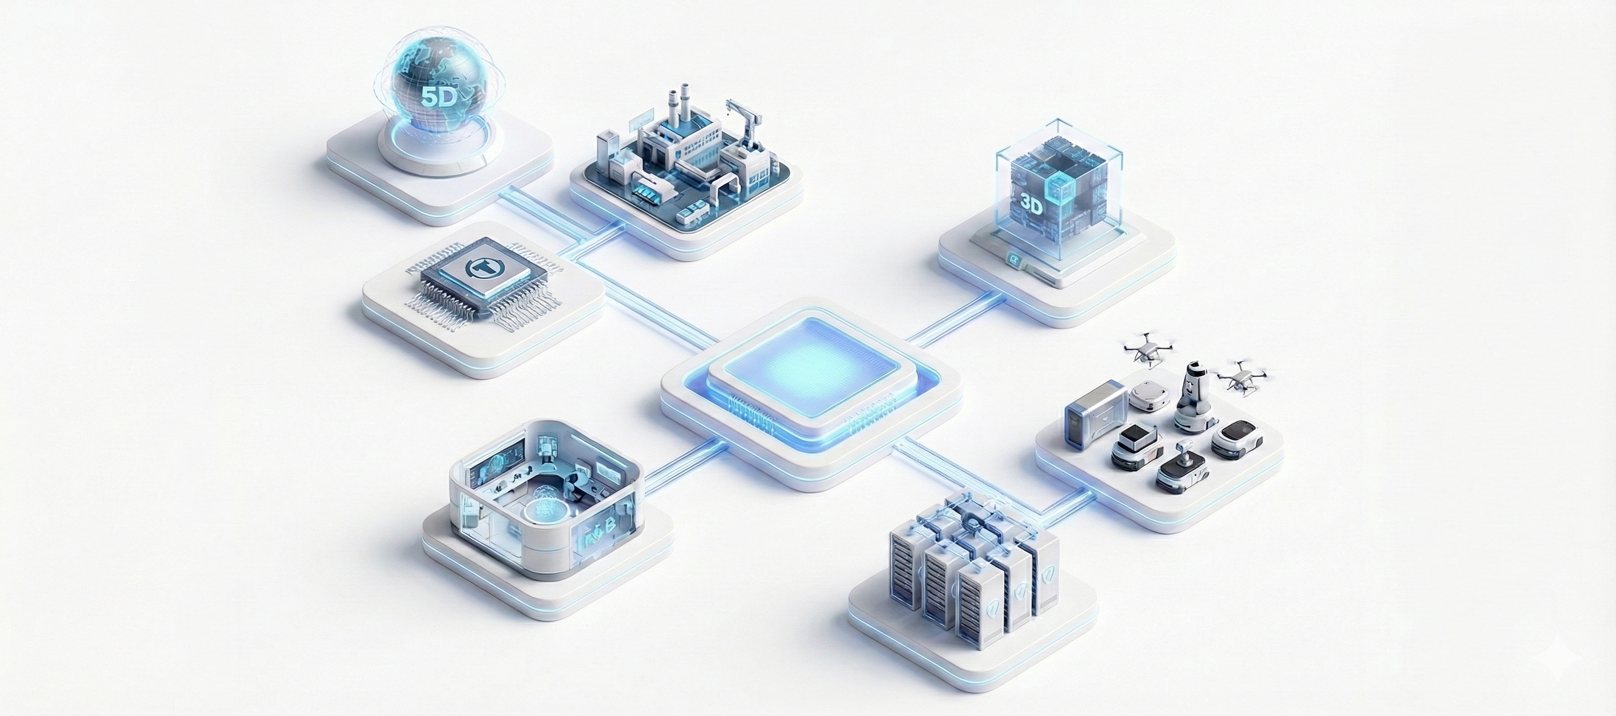

What Collaverse is
Industrial Spatial & Operations Platform for Semiconductor Fabs
Collaverse integrates design, construction, and operations data into a single spatial, object‑based structure.
It treats fabs not as static facilities, but as continuously evolving operational systems where every change is captured, traceable, and usable.
Why It Matters
Data fragmented across CAD, documents, and files
Change history scattered and often lost
Design intent disconnected after construction
No reliable basis for operational decision‑making
How Collaverse Is Different
Single spatial, object‑based model for all design–construction
–operations data
Time‑based change accumulation & full traceability
Coordinate/object standards enabling independent collaboration across tools
Operational data continuity that preserves designintent into
real operations

Slide 4





Why Fabs Struggle – and the Structural Fix
Semiconductor Fabs rely on disconnected, file‑based workflows that cannot support continuous change or secure multi‑party collaboration.
Structural Problems in Industrial Sites
Design·Construction·Operations data fragmented
No persistent change history
Data loss between collaboration tools and formats
Design intent lost after construction
No accumulated basis from operational decision-making
Collaverse Structural Fix
Single spatial, object-based model
Time-based change history & traceability
Coordinate / object standards for independent collaboration
Operational data continuity preserving design intent
Execution context based on space, state, and time
What This Enables
Real‑time understanding of what is built & changed
Reliable handover with preserved design intent
Reduced rework & lower collaboration risk
Faster, safer decision‑making

Slide 5
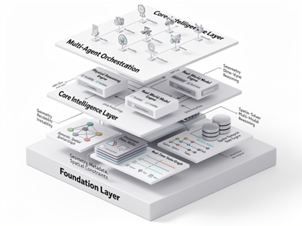
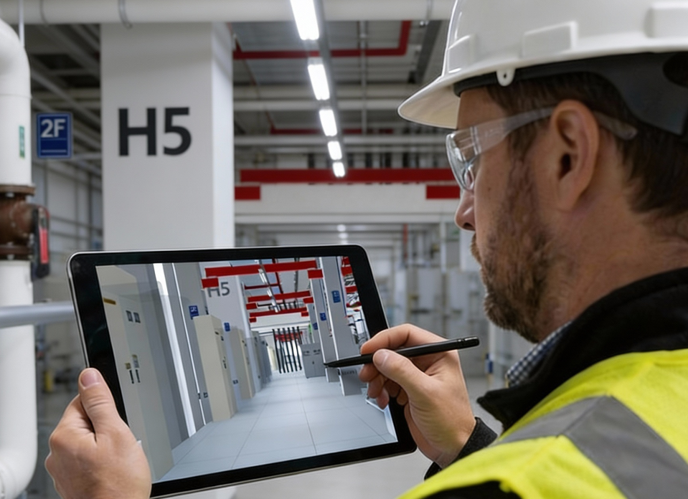
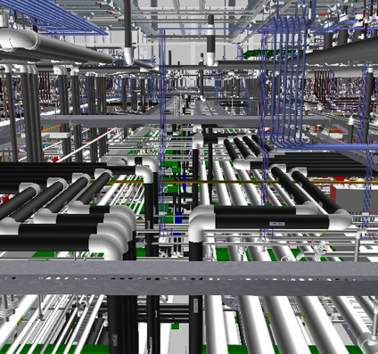
Architecture for Secure, Multi-Party Collaboration
Built for Secure, Multi-Party Collaboration at Fab Scale
Semiconductor Fabs require strict access control and secure data handling, yet depend on continuous coordination across internal teams,
secure zones, and external partners. Traditional file‑based BIM workflows cannot preserve change history or support real‑time
collaboration under these constraints
Core Platform Capabilities
Multi‑user real‑time collaboration
Role‑ and permission‑based access control
Time‑based change history with full traceability
Internal/external impact analysis
Design & field change tracking
CVX:
Secure Collaboration Data Format
Encrypted, version‑controlled collaboration data
Designed for security‑restricted environments
Enables collaboration across internal networks,
secure zones, and external partners
Protects against tampering while preserving full history
Outcome
Reliable design validation, stable field execution, reduced duplicate work and rework, and lower
collaboration risk.

Slide 6
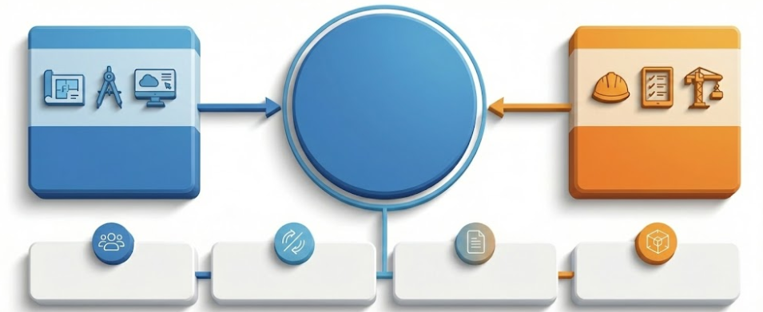

Solution 1. Collaverse Standard
Spatial Collaboration and Verification platform for large-scale industrial projects
Provides a unified spatial data structure across design, engineering, MEP, and construction,
enabling reliable design validation and stable field execution.
Trusted
Design Foundation
Reduced Field Execution Risk
Collaboration Across Project Teams
Design & Engineering Teams
(BIM, MEP)
Field Execution
& Construction
(QA/QC)
MEP engineers and BIM design teams
Construction and field execution teams
QA/QC execution teams
Large industrial facility project teams
Spatial Collaboration and Verification Platform
Field condition-based design validation
Construction error prevention and verification
Minimized design-construction mismatch
Integrated BIM/CAD design collaboration
Spatial-based validation of design results
Time-based change history tracking
Problems Solved by Collaverse
Mismatch between design intent and field execution
Manual document-based verification
Broken change-history traceability
Fragmented BIM · DWG · Construction data
Live Collaboration
Change Intelligence
Data & Reporting
Model Performance
Multi-user real-time collaboration
Spatial-based coordination
Role-based access control
Time-based change history management
Internal/external impact analysis
Design & field change tracking
BOM, DWG, report extraction
Object-attribute data management
External system data output
Large-scale 3D processing
High-density spatial data handling
Accurate Fab-scale validation

Slide 7
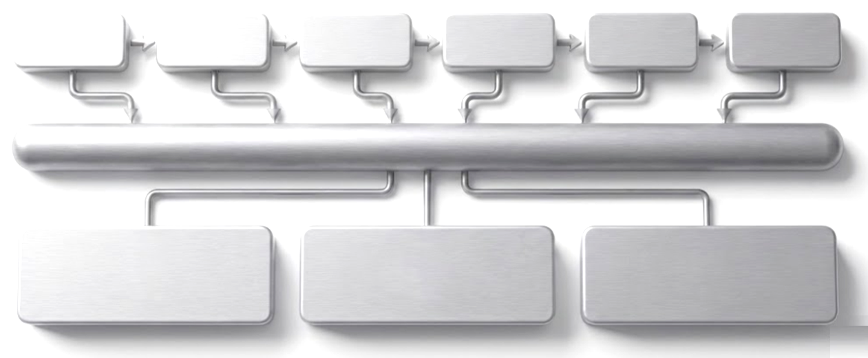
Solution 2. CVX
Structured collaboration data format for design – construction – fieldwork in security-restricted environments.
Enables collaboration across internal networks, secure zones, and external partners while preserving project context and change history.
Core Capabilities
All phase data connected and managed by CVX / Maintaining time-based change history, not snapshots
Encrypted, version-controlled data format
Time-based change history tracking
Bidirectional BIM/CAD integration
Collaboration in security-restricted environments
BIM Design
Modeling
DWG / Review
Construction
Verification
Settlement
CVX
Encrypted·Version-Controlled Collaboration Data Format
Value Delivered by CVX
Data Integrity
Real-Time Traceability
Elimination of Redundant Work
Data integrity ensured
Reduced duplicate work and rework
Faster change response
Lower collaboration risk
Encrypted CVX format
Selective sharing of approved data
Protection against change-history tampering
Time-based change accumulation
End-to-end design-construction-verification tracking
Root-cause and impact analysis
Single data stack maintained
Minimal file copying and rework
Reduced collaboration cost

Slide 8
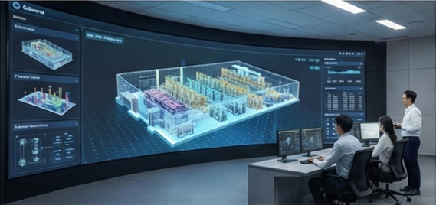
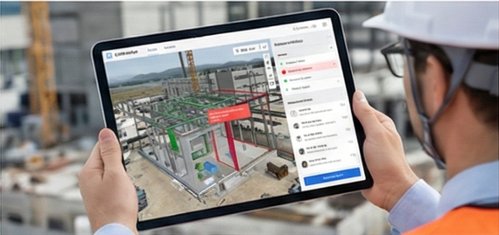
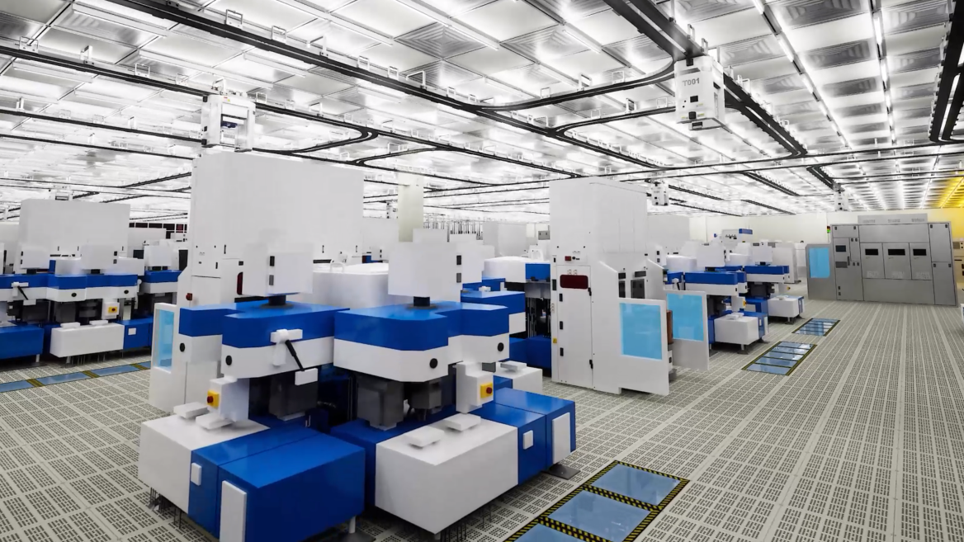
Semiconductor Use Cases
Where Collaverse Is Used — and What Improves
Use Case A
Use Case B
Use Case C
MEP & Infrastructure Coordination
(Design / Construction)
Before: Fragmented BIM/DWG data, manual
validation, high field execution risk
After: Unified spatial data, time‑based change
tracking, reduced execution risk
Equipment Hook‑Up Design & Verification
(Field Execution / QA‑QC)
Before: Field mismatch, slow QA/QC cycles, construction errors
After: Field‑condition validation, error
prevention, faster verification, BOM/DWG/
report extraction
Operational Transition & Ramp‑Up Support
(Handover → Ops)
Before: Design intent lost, no traceable change history, slow ramp‑up
After: No data gaps, preserved design intent,
spatial traceability, faster operational readiness

Slide 9
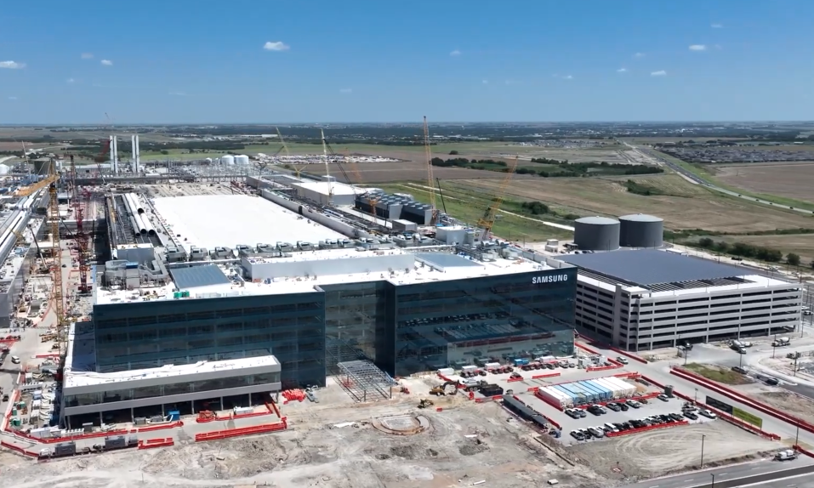
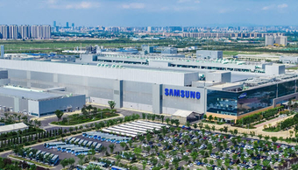

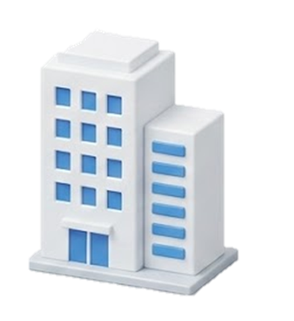
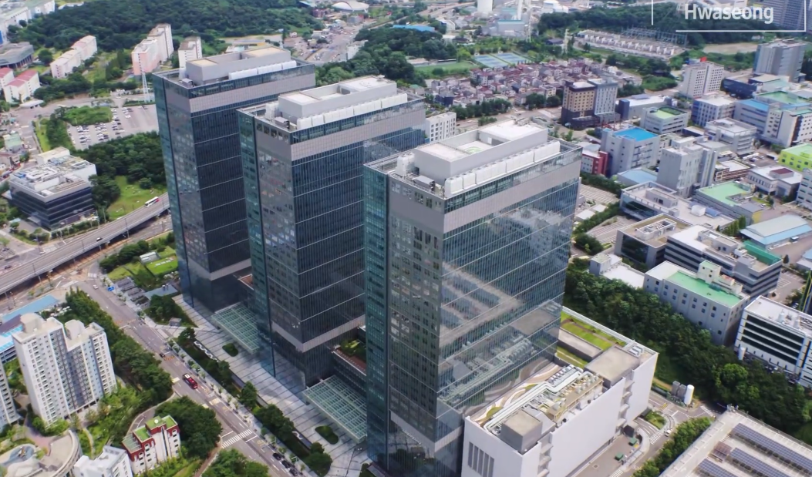
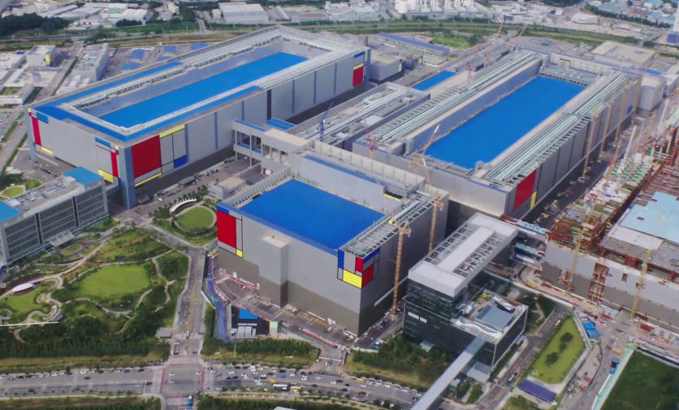
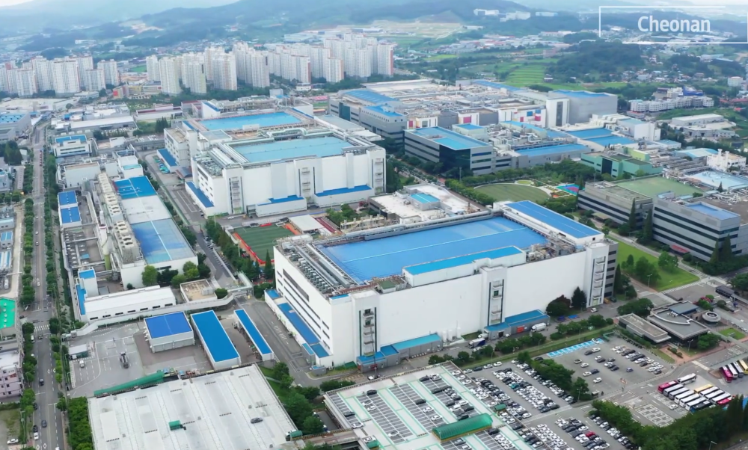
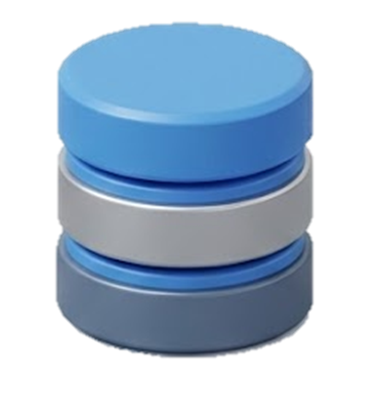
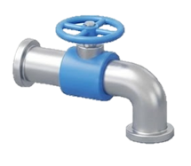
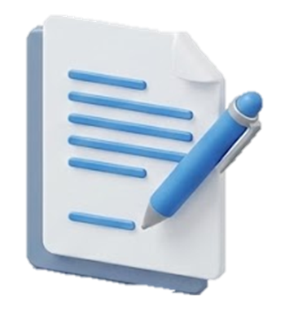
Proof of Scale & Reliability
Since 2013, the system has operated reliably in mission-critical environments with zero data integrity failures.
Verified Scale & Operational Track Record
23 global semiconductor Fab projects
2.2M㎡ of manufacturing space
200B㎥ of high-density spatial data
86,000km of piping and infrastructure
34 intellectual property assets
Taylor, TX
Xi’an, China
Hwaseong
Pyeongtaek
Cheonan
(South Korea)
[ Applied Sites ]

Slide 10
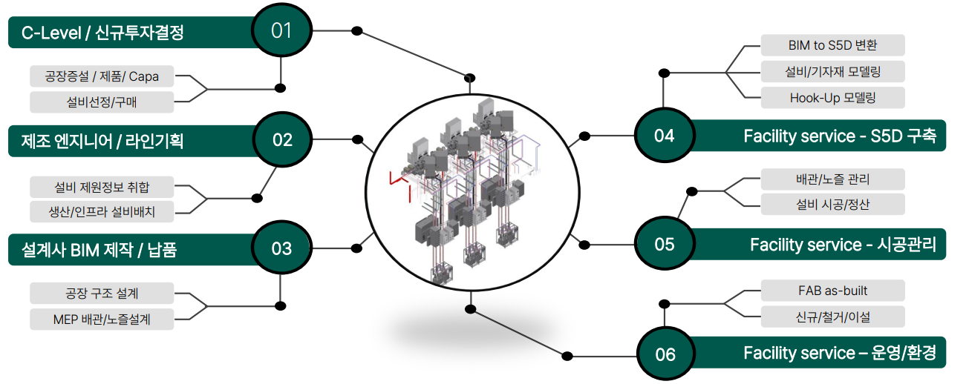
Lifecycle Continuity (Design → Construction → Operation)
Continuous Data Flow Across the Full Fab Lifecycle
Collaverse preserves spatial and change context from design through construction and into operations—ensuring no data gaps and no loss of design intent.
C-Level / Investment Decision
BIM to SSD Conversion
Plant Construction / Product / Capa
Equipment / Infrastructure Modeling
Equipment Selection / Procurement
Hook-up Verification
Manufacturing Engineering / Line Planning
Facility Service – S5D Deployment
Equipment Specifications
Piping / Structure Control
Production / Process Equipment
Equipment Installation / Inspection
Design / BIM Production / Delivery
Facility Service – Construction Management
Process Structure Design
FAB as-built
MEP Routing / Layout Design
New Installation / Relocation
Facility Service – Operations / Environment
Notes:
Lifecycle Continuity Includes:
Design & Construction
Secure External Collaboration
Operational Transition
What This Enables
Spatial/state‑based data continuity
Handover with preserved design intent & change history
Execution context for operational decisions
Faster, safer ramp‑up

Slide 11

Together Great
Great Together
Collaboration is how we build greatness.

